Slide 1
ROBUST PROGRAMS AND MITIGATION STRATEGIES
LECTURE 9: SECURE AND RESISTANT PROGRAMS

Slide 2
Overview
“Safety” can imply a lot of things
  Entire areas in software engineering devoted to:
    Fault tolerance
    Reliability
    Formal methods for correctness
    Fault avoidance
    Failure mode analysis
This discussion is at a much lower level:
  What simple programming practices can we adopt at a low-level to improve the correctness and robustness of our source code?
    One-half of this (or more) is in personal quality practices such as unit testing, code reviews, and coding standards
    Other half is in the approach to coding itself (today’s topic)

Slide 3
Correctness vs. Robustness
Correctness:
  “…never returning an inaccurate result; returning no result is better than returning an inaccurate result”
  Example: Mission-critical applications
Robustness:
  “…always trying to do something that will allow the software to keep operating, even if it leads to results that are inaccurate sometimes.” (McConnell, Code Complete 2, p. 197)
  Example: Most consumer applications

Slide 4
Vulnerabilities in Applications
There are many well-known security vulnerabilities that exist in many web applications. Here are some examples:
  SQL injection: where a malicious user executes SQL commands on the back-end database by providing specially formatted input
  Cross site scripting (XSS): causes the attacker to execute a malicious script at a user’s browser
  Malicious file execution: where a malicious user causes the server to execute malicious code
  Bufferoverflow
These vulnerabilities are typically due to
  errors in user input validation and sanitization or
  lack of user input validation and sanitization

Slide 5
All Input is Evil
One should always take it that All input is evil:
  At least potentially
  Input can be: (A random collection)
    Files
    Web forms
    Cookies
    Registry entries
    Database contents
    Command line arguments
    Environmental variables
    HTTP requests
    Named pipes
    E-mail
    …

Slide 6
Sources of Input that Need Validation
What are sources of input for local applications?
  Command line arguments
  Environment variables
  Configuration files, other files
  Inter-Process Communication call arguments
  Network packets
What are sources of input for web applications?
  Web form input
  Scripting languages with string input
Lwomwa Joseph
Kendall & Kendall

Slide 7
Data-Entry/Input Methods
Data-entry/input methods include
  Keyboards
  Optical character recognition
  Magnetic ink character recognition
  Mark-sense forms
  Bar codes
  Intelligent terminals
Lwomwa Joseph
Kendall & Kendall
19-<number>

Slide 8
Finding Common Entry Points
Files
  Contain data specified by users
  Contain data supplied by application
  Can be intentionally or unintentionally corrupted
  Attacker can also attack file metadata:
    Extension
    Path
    File system attributes
    …

Slide 9
Why consider the interface and its input areas
Consider all user input as harmful until proven otherwise.
Look for valid input and deny everything else. Do not do the opposite and look for invalid data, reject it, and then let everything else in.
  Hackers can circumvent client-side validation. Consider performing validation often and close to the threats. For example, validate data on the server before committing it to a database.
  Invalidate input that is too large.
  Invalidate input that contains dangerous characters or keywords, such as scripting elements (<script>, <object>), reserved SQL characters and keywords (- -, INSERT, xp_cmdshell), or file traversal characters (..\).

Slide 10
Why consider the interface and its input areas
Use the mantra: Constrain, Reject, and Sanitize.
  One of the most powerful ways to constrain data input is through validation controls and regular expressions.
  The example regular expression ( \w+([-+.]\w+)*@\w+([-.]\w+)*\.\w+([-.]\w+)* ) checks that the input string is of the correct form for an Internet e-mail address.

Slide 11
Robust Design and Programming Strategies
Input Control
  Input control includes the necessary measures to ensure that input data is correct, complete, and secure.
  A systems analyst must focus on input control during every phase of input design, starting with source documents that promote data accuracy and quality.
  A system analyst must take into consideration
    Access – legal channels of getting resources
    Identification – to uniquely distinguish a user of a resource
    Authentication – to prove positively that the user is what he/she claims to be.
    Authorization – being able to determine and allow the user only those resources the user has ability to utilize.
Lwomwa Joseph
Kendall & Kendall

Slide 12
Robust Programming
Called method is responsible for ensuring the integrity of the input
  All input must be validated before the function is run
  Decide a priori how to handle bad inputs
Example (Wikipedia):
intlow_quality_programming(char *input){
char str[1000+1]; // one more for the null char
strcpy(str, input); // copy input
...
}
inthigh_quality_programming(char *input){
char str[1000+1]; // one more for the null character
strncpy(str, input, 1000); // copy input, only copy
//a maximum length of 1000 characters
str[1000] = '\0'; // add terminating null character
...
}
Defensive Programming is paranoid;
it assumes “Murphy’s Law”: whatever can go wrong, (eventually) will
Based on Chapter 8, Code Complete 2, Steve McConnell

Slide 13
Robust Design and Programming Strategies
Input Control
  Every piece of information should be traceable back to the input data
  You must provide
  Audit trail
    An audit trail records the source of each data item and when it entered a system. In addition to recording the original source, an audit trail must show how and when data is accessed or changed, and by whom. All these actions must be logged in an audit trail file and monitored carefully.
  Data security
    Data security protects data from loss or damage and recovers data when it is lost or damaged.
  Records retention policy
    A records policy that is designed to meet all legal requirements and business needs for keeping records
Lwomwa Joseph
Kendall & Kendall

Slide 14
Robust Design and Programming Strategies
One of the paradoxes of defensive programming is that during development, you’d like an error to be noticeable—you’d rather have it be obnoxious than risk overlooking it. But during production, you’d rather have the error be as unobtrusive as possible, to have the program recover or fail gracefully. Here are some guidelines for deciding which defensive programming tools to leave in your production code and which to leave out:

Slide 15
Robust Design and Programming Strategies
When designing programs we need to ensure that they are robust.
Failure to do this may result in two critical outcomes:
The program wont function correctly / will not do the job its supposed to do.
The program may be unsecure and data that it holds may become compromised.
Both outcomes are unacceptable. Luckily there are a ways that we can minimise these issues, through defensive design strategies, which will ensure the robustness of our software solutions:
Input Sanitisation
Anticipating Misuse and Input Validation
Authentication
Maintainability of Code
Testing
Robust Learning Objectives :
To understand…
- Robust design considerations:
o input sanitisation/validation
o planning for contingencies
o anticipating misuse
o authentication
- maintainability:
o comments
o indentation
- the purpose of testing
- types of testing:
o iterative
o final/terminal
- how to identify syntax and logic errors
- selecting and using suitable test data.

Slide 16
Unwanted Inputs
Input Sanitisation
What do we mean by input validation function and input sanitization function?
Input validation …
Input sanitization function is a function which takes a set of inputs which may contain a subset of malicious values and gives a set of outputs that only contain benign values
Validation checks if the input meets a set of criteria (such as a string contains no standalone single quotation marks).
Sanitization modifies the input to ensure that it is valid (such as doubling single quotes).
You would normally combine these two techniques to provide in-depth defense to your application.

Slide 17
Input Sanitisation
Input Sanitisation
This is where data entered is cleaned of any unwanted characters that the user may enter.
For example, if a user is entering a password, it may be sensible to strip out any spaces, so to avoid the potential security threat of an SQL injection attack.
…what is an SQL injection??

Slide 18
Input Validation
Input Validation
Validation
  Ensuring that the specification is correct
  Determine that the software to be built is actually what the user wants!
Verification
  Ensuring that the software runs correctly
Input validation is when a system will check that the input meets certain criteria, so to ensure that the data is in an acceptable form.
For example, if a user is to input their email address to enable them to sign up to a user account, input validation can check to see if the entered email address in the expected form (contains an @ symbol and ends with a domain type (.co.uk)).
If the entered address doesn’t contain these items then it can be rejected in order to ensure that only valid data is entered by the user.

Slide 19
Validation Checks
    Data type check: is used to ensure that a data item fits the required data type. For example, a numeric field must have only numbers or numeric symbols, and an alphabetic field can contain only the characters A through Z or the characters a through z.
    Range check – limit check: tests data items to verify that they fall between a specified minimum and maximum value. The daily hours worked by an employee, for example, must fall within the range of 0 to 24.
    Validity check: is used for data items that must have certain values. For example, if an inventory system has 20 valid item classes, then any input item that does not match one of the valid classes will fail the check.
    Combination check: performed on two or more fields to ensure that they are consistent or reasonable when considered together. Even though all the fields involved in a combination check might pass their individual validation checks, the combination of the field values might be inconsistent or unreasonable.

Slide 20
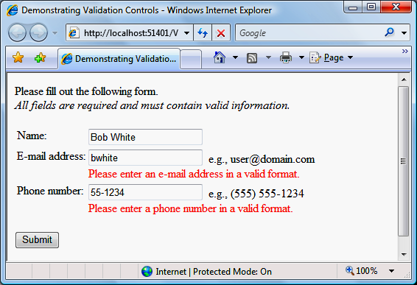
Validation Controls Exercise

Slide 21
Whitelists and Blacklists
Deciding on what to sanitise and validate…
There are of course an overwhelming number of different inputs that users could enter into a system and to plan against every one can be a very difficult process.
Software developers will often use whitelists or blacklists to help them plan against unwanted inputs.
A whitelist is a lists of data that the program being created, should accept. All other data should be rejected by the program.
A blacklist is a list of data that the program being created, should reject. All other data should be accepted by the program.
Which do you think will be the most effective at preventing unwanted inputs and why?

Slide 22
Authentication
Authentication
Another defensive strategy is to ensure that systems have some form of authentication.
In other word, having passwords to only allow certain users…
…and potentially limiting the access of the various parts of the system (access rights).
Security can be increased further by ensuring that users update their password regularly, have complex passwords and limit login attempts.

Slide 23
String Analysis
String analysis determines all possible values that a string expression can take during any program execution
Using string analysis we can identify all possible input values of the sensitive functions
  Then we can check if inputs of sensitive functions can contain attack strings
How can we characterize attack strings?
  Use regular expressions to specify the attack patterns
  Attack pattern for XSS: Σ∗<scriptΣ∗
If string analysis determines that the intersection of the attack pattern and possible inputs of the sensitive function is empty
  then we can conclude that the program is secure
If the intersection is not empty, then we can again use string analysis to generate a vulnerability signature
    characterizes all malicious inputs
  Given Σ∗<scriptΣ∗ as an attack pattern:
    The vulnerability signature for $_GET[”www”] is
    Σ∗<α∗sα∗cα∗rα∗iα∗pα∗tΣ∗ where α∉ { A-Za-z0-9 .-@:/ }

Slide 24
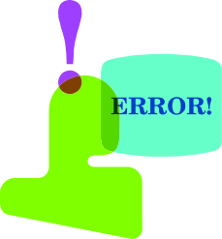
Robust Programming Techniques
1. Error-handling
  Most errors are not expected, but they are known
  Plan for these errors and your recovery action(s)
Possible error handling strategies:
  Return a neutral value (zero, empty string, etc.)
  Substitute the next piece of valid data – particularly useful in systems that process continuous data feeds
  Return the same answer as the previous invocation
  Substitute closest legal value (zero, bounded array)
  Log a warning message to a file (usually do anyway)
  Return an error code, delegate to dedicated handlers
  Centralize error handling
  Handle the error locally* (this is the best alternative!)
  Abort the request and possibly shut down the system
Based on Chapter 8, Code Complete 2, Steve McConnell

Slide 25

Robust Programming Techniques
2. Exception Handling
  Exceptions represent an unexpected but not unanticipated behavior of the system.
  Exceptions are intrusive; they violate encapsulation and ordered control flow principles
Best Practices
Throwing an exception in a method implementation:
  Use exceptions for unexpected situations that shouldn’t be ignored
  Throw an exception only in exceptional situations
  Include in an exception all information available regarding the exceptional situation
  Exception handling should be in the called method
  Standardize your project’s use of exceptions!
Based on Chapter 8, Code Complete 2, Steve McConnell

Slide 26
Robust Programming Techniques
Best Practices (Exception Handling, continued)
Handling an exception in a method implementation
  Do not ignore exceptions if thrown to you
    Called “swallowing” exceptions
    try {
    <some code that could throw an exception here>
    } catch (SomeException se) {}
    Be aware of the exceptions a 3rd party library you rely on may generate; consider strategies for handling if it does.
  Handle as much of an exception as you can, then re-throw with as much information as possible.
  Consider consistent design strategies
    Centralized exception reporting mechanism
    “Stateful” components that can be queried in exception cases
Based on Chapter 8, Code Complete 2, Steve McConnell

Slide 27
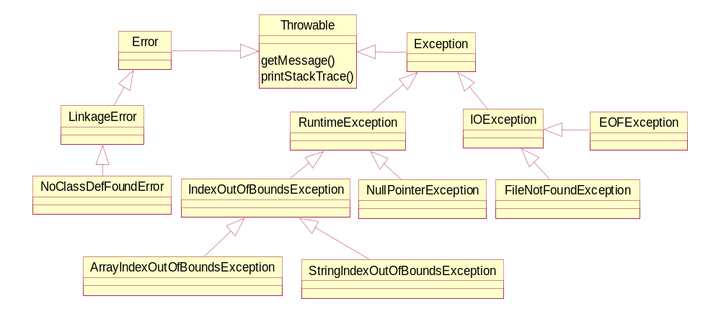
In-depth: Java Exceptions
Partial view of Java exception hierarchy:
Catching an exception’s parent catches all children
  Catching Exception catches all predefined exceptions
  Catching Throwable catches everything

Slide 28
Exception Types
“Checked” exceptions must be caught or thrown to caller
  Catching a parent also catches children
“Unchecked” exceptions need not be handled
  However, if not handled exception continues to propagate
  Error &RuntimeExceptionhierarchies contain unchecked exceptions
Developers may define their own Exceptions
  May be checked or unchecked
  Architectural policy decision
  Use to translate from low-level issue to application-level semantics
try {
// try to open a database connection here
Connection cn = ConnectionFactory.getConnection(“PaymentDB”);
PreparedStatementps = cn.prepareStatement(“Insert into payments values (?, ?, ?)”, id, name, amt);
ps.executeStatement();
conn.commit();
} catch (SQLException) {
throw new PaymentProcessException(“Unable to process your payment due to internal error SQL-0033”);
}

Slide 29
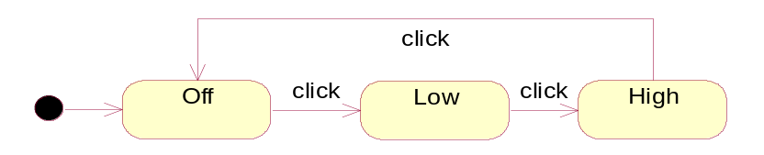
Using a SM to Handle Exceptions
One way to consider exceptions isin the context of a SM:
What if the light bulb burns out?
  Could handle as a condition on all transitions for Lamp
  Or we could treat as an “exceptional” circumstance and take corrective action – replace the bulb
Use Java type system to handle types of Exceptions
  LightBulbException extends java.lang.Exception
Lamp
State Machines & Exceptions:
  If an exception represents an unexpected but not unanticipated state, then:
    That unanticipated state will be represented in the “full” state machine
    But, it won’t be visited much (if at all)
    The transition will not be well-defined, because you didn’t anticipate transitioning to that state during normal operation of the object anyway!

Slide 30
Exceptions
Exceptions – a better error handling
  Exceptions are a mechanism that provides the best of both worlds.
  Exceptions act similar to method return flags in that any method may raise and exception should it encounter an error.
  Exceptions act like global error methods in that the exception mechanism is built into Java; exceptions are handled at many levels in a program, locally and/or globally.
Exception Handling in Java

Slide 31
Exceptions
How are they used?
  Exceptions fall into two categories:
    Checked Exceptions
    Unchecked Exceptions
  Checked exceptions are inherited from the core Java class Exception. They represent exceptions that are frequently considered “non fatal” to program execution
  Checked exceptions must be handled in your code, or passed to parent classes for handling.
  Unchecked exceptions represent error conditions that are considered “fatal” to program execution.
  You do not have to do anything with an unchecked exception. Your program will terminate with an appropriate error message.
Exception Handling in Java

Slide 32
Exceptions
How do you handle exceptions?
  Exception handling is accomplished through the “try – catch” mechanism, or by a “throws” clause in the method declaration.
  For any code that throws a checked exception, you can decide to handle the exception yourself, or pass the exception “up the chain” (to a parent class).
  To handle the exception, you write a “try-catch” block. To pass the exception “up the chain”, you declare a throws clause in your method or class declaration.
  If the method contains code that may cause a checked exception, you MUST handle the exception OR pass the exception to the parent class (remember, every class has Object as the ultimate parent)
Exception Handling in Java

Slide 33
Coding Exceptions
Try-Catch Mechanism
  You may also write an optional “finally” block. This block contains code that is ALWAYS executed, either after the “try” block code, or after the “catch” block code.
  Finally blocks can be used for operations that must happen no matter what (i.e. cleanup operations such as closing a file)
Example
  try {
  … normal program code
  }
  catch(Exception e) {
  … exception handling code
  }
Exception Handling in Java

Slide 34
Coding Exceptions
Passing the exception
  In any method that might throw an exception, you may declare the method as “throws” that exception, and thus avoid handling the exception yourself
  Example
    public void myMethod throws IOException {
    … normal code with some I/O
    }
Exception Handling in Java

Slide 35
Code Examples
1. Demonstration of an unchecked exception (NullPointerException)
2. Demonstration of checked exceptions:
  Passing a DivideByZeroException
  Handling a DivideByZeroException
Exception Handling in Java

Slide 36
Trace a Program Execution
animation
try {
statement1;
statement2;
statement3;
}
catch(Exception1 ex) {
handling ex;
}
catch(Exception2 ex) {
handling ex;
throw ex;
}
finally {
finalStatements;
}
Next statement;
statement2 throws an exception of type Exception2.

Slide 37
Robust Programming Techniques
Other useful techniques:
3. Logging
  Dump as much output during program execution as you can computationally afford to do.
  Trap abnormal system exits and provide dump
4. Use Aspects to augment behaviors during development and testing
  Can introduce logging, pre/post checks, etc. without the code intrusion caused by other techniques.
5. Apply various Design Patterns to create regions of code that can make safety assumptions
  A region could be defined by class, package, or component interaction boundaries
  See next slide

Slide 38
Robust Programming Techniques
6. Assertions
An assertion is code that’s used during development—usually a routine or
macro—that allows a program to check itself as it runs. When an assertion is true, that means everything is operating as expected. When it’s false, that means it has detected an unexpected error in the code. For example, if the system assumes that a customer-information file will never have more than 50,000 records, the program might contain an assertion that the number of records is less than or equal to 50,000. As long as the number of records is less than or equal to 50,000, the assertion will be silent. If it encounters more than 50,000 records, however, it will loudly “assert” that there is an error in the program.
Assertions are especially useful in large, complicated programs and in high reliability programs. They enable programmers to more quickly flush out mismatched interface assumptions, errors that creep in when code is modified, and so on.

Slide 39
Robust Programming Techniques
Assertions
  Typically a boolean condition that takes some notification action when the condition is false
  Supported in many languages: VB, C++, Java
  Best Practices for Assertions
    Used during development and test; not used when the code is deployed to production!
    False assertions should fail hard; these scenarios represent situations that were never expected to occur!
    Avoid putting executable code in assertions
      E.g. “assert Util.check(obj)” where method check modifies obj
    Use to document and verify pre/post conditions
Based on Chapter 8, Code Complete 2, Steve McConnell

Slide 40
Robust Programming Techniques
Use assertions to document assumptions made in the code and to flush out unexpected conditions. Assertions can be used to check assumptions like these:
● That an input parameter’s value falls within its expected range (or an output parameter’s value does)
● That a file or stream is open (or closed) when a routine begins executing (or when it ends executing)
● That a file or stream is at the beginning (or end) when a routine begins executing (or when it ends executing)
● That a file or stream is open for read-only, write-only, or both read and write
● That the value of an input-only variable is not changed by a routine
● That a pointer is non-NULL
● That an array or other container passed into a routine can contain at least X number of data elements
● That a table has been initialized to contain real values
● That a container is empty (or full) when a routine begins executing (or when it finishes)

Slide 41
Robust Programming Techniques
Assertions
Use error handling code for conditions you expect to occur; use assertions for conditions that should never occur
Assertions check for conditions that should never occur. Error handling code checks for off-nominal circumstances that might not occur very often, but that have been anticipated by the programmer who wrote the code and that need to be handled by the production code. Error-handling typically checks for bad input data; assertions check for bugs in the code.
If error handling code is used to address an anomalous condition, the error handling will enable the program to respond to the error gracefully. If an assertion is fired for an anomalous condition, the corrective action is not merely to handle an error gracefully—the corrective action is to change the program’s source code, recompile, and release a new version of the software.
A good way to think of assertions is as executable documentation—you can’t rely on them to make the code work, but they can document assumptions more actively than program-language comments can.

Slide 42
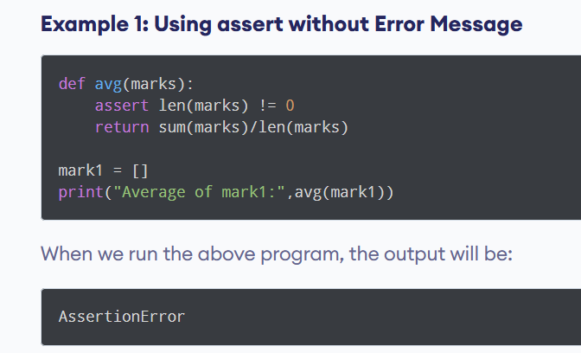
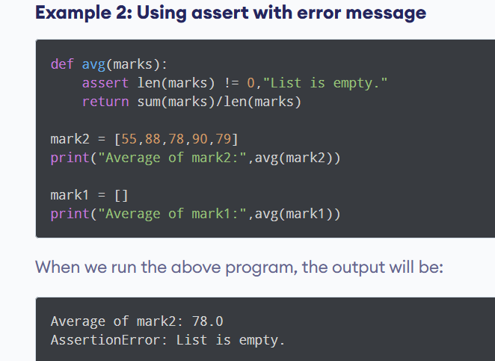
Assertions in Python:

Slide 43
Robust Programming Techniques
Assertions in Java:
General Form: asset Expr1 : Expr2
  Where Expr1 is a boolean expression and Expr2 is generally a String.
  Examples:
assert denominator != 0 : “Division by zero!”;
assert operand > 0 : “Square root operand should be non-negative”
Java assertions are enabled at runtime
  A behavior of the classloader
// Enables assertions for the entire application
% java –ea <your Main class here>
// Enabling assertions only for TestClass and package TestPackage
% java –ea:TestClass –ea:TestPackage
// Enable assertions for default package, disable for TestPackage
% java –ea:… -da:TestPackage

Slide 44
7. Regular Expressions
Defined: A method of specifying a search string using a number of special characters that can precisely match a substring.
Purpose: Regular expressions allow you to perform complex pattern matching on strings. A small regular expression can replace the need for a large amount of code
Example for e-mail validation:
  ^[A-Za-z0-9._%-]+@[A-Za-z0-9._%-]+\.[A-Za-z]{2,4}$

Slide 45
Regular Expressions
Regular expressions are a language for string patterns.
RegEx is integral to many programming languages:
• Perl
• Python
• Javascript
• PHP
• C/C++
• grep (in Unix)
• Java (java.util.regex.*)
and many more
RegEx is often the best way to validate String input.
A RegEx is compared with a String, looking for a “match”.

Slide 46
Some definitions
Actual data that we are going to work upon (e.g. an email address string)
‘rob@example.com’
'/^[a-z\d\._-]+@([a-z\d-]+\.)+
[a-z]{2,6}$/i‘
preg_match(), preg_replace()
Definition of the string pattern (the ‘Regular Expression’).
PHP functions to do something with data and regular expression.

Slide 47
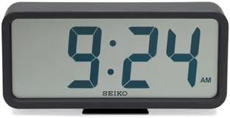
Regular Expression Notation
Any single character is a regex.
The period (‘.’) is a regex. (A period matches any single character.)
If R₁ and R₂ are regexs, then so is
-- matches R₁ followed immediately by R₂
Examples
(red|blue) fish
(0|1|2|3)(A|B|C).!
Write a regEx to match any possible digital time.
-?(0|1|2|3|4|5|6|7|8|9)+
(0|1|2|3|4|5|6|7|8|9){3}-(0|1|2|3|4|5|6|7|8|9){4}
Write a regEx to match any possible Social Security Number

Slide 48
So.. An example
Lets define a regex that matches an email:
$emailRegex = '/^[a-z\d\._-]+@([a-z\d-]+\.)+[a-z]{2,6}$/i‘;
Matches: ‘rob@example.com’,
‘rob@subdomain.example.com’
‘a_n_other@example.co.uk’
Doesn’t match: ‘rob@exam@ple.com’
‘not.an.email.com’

Slide 49
So.. An example
/^
[a-z\d\._-]+
@
([a-z\d-]+\.)+
[a-z]{2,6}
$/i
Starting delimiter, and start-of-string anchor
User name – allow any length of letters, numbers, dots, underscore or dashes
The @ separator
Domain (letters, digits or dash only). Repetition to include subdomains.
com,uk,info,etc.
End anchor, end delimiter, case insensitive

Slide 50
Boolean Matching
We can use the function preg_match() to test whether a string matches or not.
// match an email
$input = ‘rob@example.com’;
if (preg_match($emailRegex,$input) {
echo ‘Is a valid email’;
} else {
echo ‘NOT a valid email’;
}

Slide 51
PHP Functions and Examples
// Check if a user's name is made up of 8-12
// alphanumeric characters
if (preg_match('/^[A-Za-z0-9]{8,12}$/', $username)) {
// OK
}
// The pattern /a[\S]*/ matches a substring that starts with
// 'a' and follows by any number of non-white space characters.
if (preg_match('/a[\S]*/', "x abc faa axx", $match) {
// $match is the first substring that matches the pattern
echo $match; // Output abc
}
if (preg_match_all(
'/a[\S]*/', "x abc faa axx", $matches) {
// $matches becomes an array containing "abc", "aa", and "axx"
}

Slide 52
Robust Programming Techniques
8. Leave in code that checks for important errors
Decide which areas of the program can afford to have undetected errors and which areas cannot. For example, if you were writing a spreadsheet program, you could afford to have undetected errors in the screen-update area of the program because the main penalty for an error is only a messy screen. You could not afford to have undetected errors in the calculation engine because the errors might result in subtly incorrect results in someone’s spreadsheet. Most users would rather suffer a messy screen than incorrect tax calculations and an audit by the IRS.
9. Leave in code that helps the program crash gracefully
The opposite is also true. If your program contains debugging code that detects potentially fatal errors, leave the code in that allows the program to crash gracefully. In the Mars Pathfinder, for example, engineers left some of the debug code in by design. An error occurred after the Pathfinder had landed. By using the debug aids that had been left in, engineers at JPL were able to diagnose the problem and upload revised code to the Pathfinder, and the Pathfinder completed its mission perfectly (March 1999).

Slide 53
Robust Programming Techniques
10. Log errors for your technical support personnel
Consider leaving debugging aids in the production code but changing their behavior so that it’s appropriate for the production version. If you’ve loaded your code with assertions that halt the program during development, you might considering changing the assertion routine to log messages to a file during production rather than eliminating them altogether.
11. See that the error messages you leave in are friendly
If you leave internal error messages in the program, verify that they’re in language that’s friendly to the user. In one of my early programs, I got a call from a user who reported that she’d gotten a message that read “You’ve got a bad pointer allocation, Dog Breath!” Fortunately for me, she had a sense of humor. A common and effective approach is to notify the user of an “internal error” and list an email address or phone number the user can use to report it.

Slide 54
Robust Programming Techniques
11. Being Defensive About Defensive Programming
Too much defensive programming creates problems of its own. If you check data passed as parameters in every conceivable way in every conceivable place, your program will be fat and slow. What’s worse, the additional code needed for defensive programming adds complexity to the software. Code installed for defensive programming is not immune to defects, and you’re just as likely to find a defect in defensive-programming code as in any other code—more likely, if you write the code casually.
Think about where you need to be defensive, and set your defensive-programming priorities accordingly.

Slide 55
CHECKLIST: Robust Programming
􀂉 Does the routine protect itself from bad input data?
􀂉 Have you used assertions to document assumptions, including preconditions and postconditions?
􀂉 Have assertions been used only to document conditions that should never occur?
􀂉 Does the architecture or high-level design specify a specific set of error handling techniques?
􀂉 Does the architecture or high-level design specify whether error handling should favor robustness or correctness?
􀂉 Have barricades been created to contain the damaging effect of errors and reduce the amount of code that has to be concerned about error processing?
􀂉 Have debugging aids been used in the code?
􀂉 Has information hiding been used to contain the effects of changes so that they won’t affect code outside the routine or class that’s changed?
􀂉 Have debugging aids been installed in such a way that they can be activated or deactivated without a great deal of fuss?
􀂉 Is the amount of defensive programming code appropriate—neither too much nor too little?

Slide 56
CHECKLIST: Robust Programming
􀂉 Have you used offensive programming techniques to make errors difficult to overlook during development?
Exceptions
􀂉 Has your project defined a standardized approach to exception handling?
􀂉 Have you considered alternatives to using an exception?
􀂉 Is the error handled locally rather than throwing a non-local exception if possible?
􀂉 Does the code avoid throwing exceptions in constructors and destructors?
􀂉 Are all exceptions at the appropriate levels of abstraction for the routines that throw them?
􀂉 Does each exception include all relevant exception background information?
􀂉 Is the code free of empty catch blocks? (Or if an empty catch block truly is appropriate, is it documented?)

Slide 57
CHECKLIST: Robust Programming
Security Issues
􀂉 Does the code that checks for bad input data check for attempted buffer overflows, SQL injection, html injection, integer overflows, and other malicious inputs?
􀂉 Are all error-return codes checked?
􀂉 Are all exceptions caught?
􀂉 Do error messages avoid providing information that would help an attacker break into the system?

